Slide 1
THESIS WRITE-UPS: DOS AND DON’TS
DR. JOAQUIN CARRASCO
READER IN CONTROL SYSTEMS
THE UNIVERSITY OF MANCHESTER

Slide 2
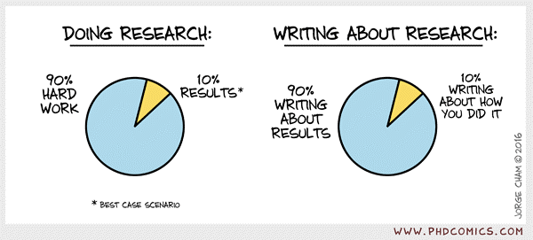
DOING VS WRITING

Slide 3
BE READY
“Give me six hours to chop down a tree and I will spend the first four sharpening the ax.”
Use some planning tool, e.g. Trello
Set deadlines!
Don’t start writing without USP

Slide 4
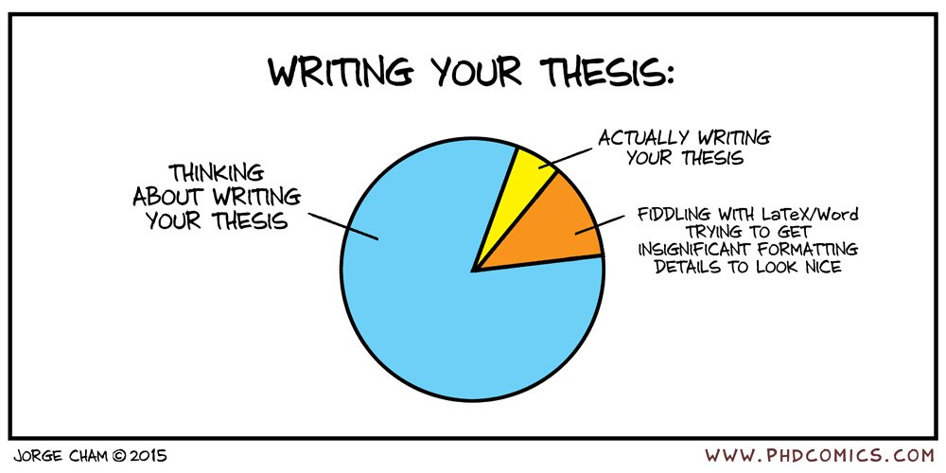
TIMING

Slide 5
FIRST STEP
Table of contents
Easy bit: your research
Difficult bit: Introduction and Conclusions
As an examiner, first parts to read are introduction and conclusions
Don’t write them on a rush!

Slide 6
STYLE
The first thing a reader will see is the style.
Consider carefully the style of your thesis
Whatever editor you use, make it look as professional as possible.
Don’t mess up with different styles. Get one, use one.
https://www.thesis-editor.co.uk/blog/post/formatting-friday-1-the-importance-of-proper-formatting

Slide 7
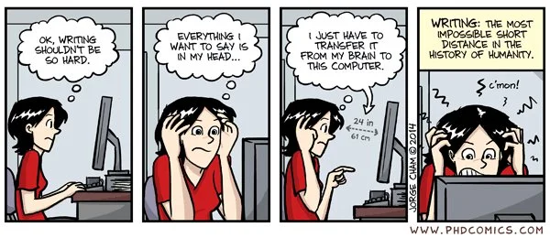
WRITING IS DIFFICULT

Slide 8
WRITE, WRITE, WRITE
Write as you go, write simple sentences.
Literature reviews are always useful
Time required to write a good introduction to your thesis is unlimited
The reader does not care about your life: Don’t use chronological descriptions
Find a writing pal

Slide 9
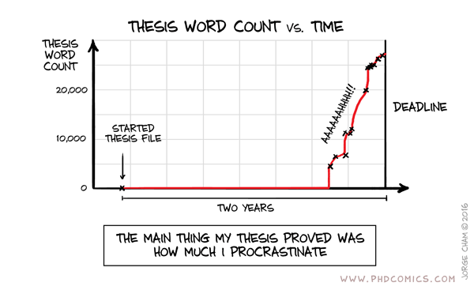
PROCRASTINATION

Slide 10
WRITING MATHS
Learn about good practice to write maths
Don’t include equations as though they were figures. They are not!
A good flow is always appreciated by the reader.
https://web.cs.ucdavis.edu/~amenta/w10/writingman.pdf
http://www.kevinhouston.net/pdf/htwm.pdf

Slide 11
WRITING MATHS

Slide 12
WRITING FIGURES
If after 5 seconds, the reader does not understand a figure, they will never understand the figure.
Use figures in the same style as provided in the literature.
Don’t use figures without a clear message for the reader. Message trumps beauty.
https://journals.plos.org/ploscompbiol/article?id=10.1371/journal.pcbi.1003833#s9
https://www.edwardtufte.com/tufte/books_vdqi

Slide 13
WRITING FIGURES

Slide 14
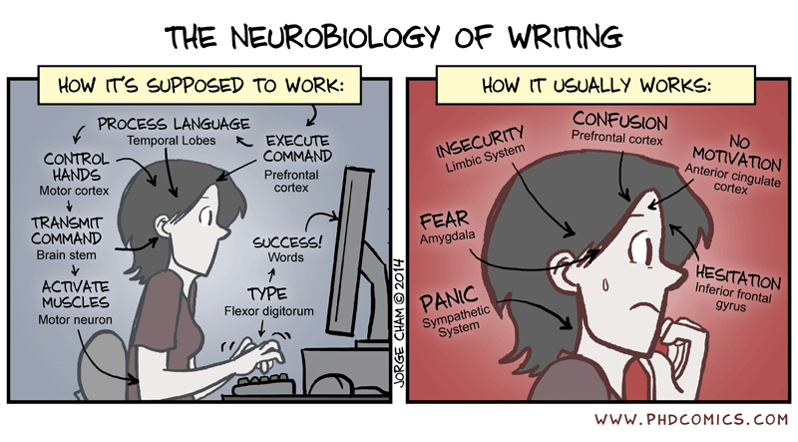
CONFUSION, INSECURITY, PANIC, FEAR,…

