Slide 1
A newly Graduate Experience
Thesis Write-up: Dos and Don'ts
Dr. Fang Liu
Department of Electrical and Electronic Engineering
School of Engineering
27/07/2022

Slide 2
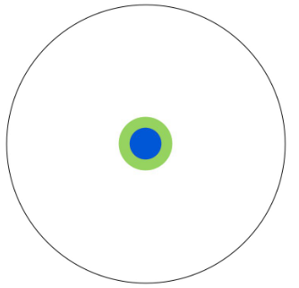
What’s a PhD?
– Matt Might
When you finish elementary and high school
Notes:
Before writing a PhD thesis, we need to what is a PhD
A computer scientist in Birmingham, circle contains all of human knowledge

Slide 3
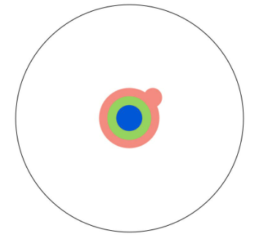
What’s a PhD? – Matt Might
Specialty with a Bachelor’s degree

Slide 4
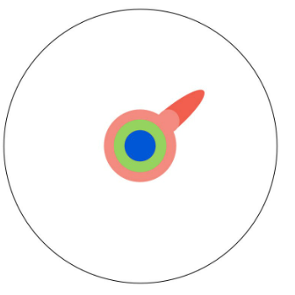
What’s a PhD? – Matt Might
Specialty deepened by a master’s degree

Slide 5
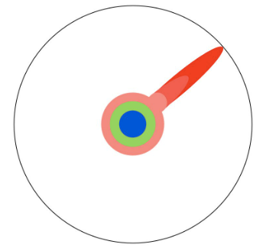
What’s a PhD? – Matt Might
Edge of human knowledge reached after reading research papers

Slide 6
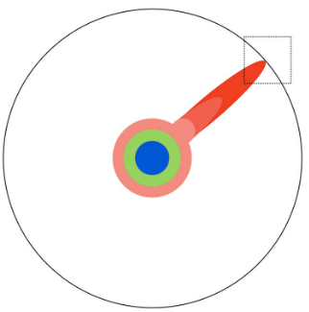
What’s a PhD? – Matt Might
Now focus on this boundary

Slide 7
What’s a PhD? – Matt Might
Push at the boundary; when it gives way, you get a PhD.

Slide 8
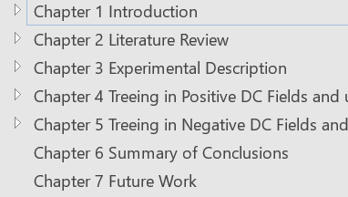
What’s a PhD thesis?
To report the boundary you’ve pushed in a logical way
Background info
Literature review
Methodology
Highlight research gap
Test results and discussion (1)
Test results and discussion (2)
Your contributions
Future work
Read theses by senior PhDs in your own group

Slide 9
Timeline of my writing
Registered Sep. 2017; three month extension (till Dec. 2020) for access to HV lab
May 2020 (late 3rd yr): Outline and a reading list (National Lockdown)
Dec. 2020 (early 4th yr): Experiments finished before Christmas break
Late-Jan. 2021: started writing
Late-May. 2021: first draft to supervisor
Late-Jul. 2021: Submission draft
Mid-Aug. 2021: Submission to Uni
Early-Oct. 2021: Viva
Late 3rd year: To form a reading list is recommend
Notes:
Outline (read thesis from previous students) for first 3 chapters; a reading list for literature review
(4) adjustment in logical flow; details and clearer explanation (figs) to be added

Slide 10
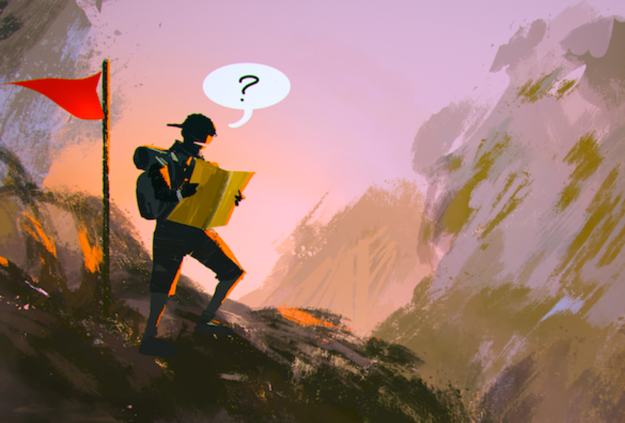
Academically, ever felt lost in writing?
National lockdown (not knowing time of reopen)
No access to labs
Experiments → Simulation? Simulation of which subject? → How to decide the reading list?
YES
Talk with supervisor, colleagues and friends in similar fields
Overwhelmed by massive data
Take data from one sample as a case study, and work out a way
Never hesitate to write down explanation notes within MATLAB codes using ‘%’

Slide 11
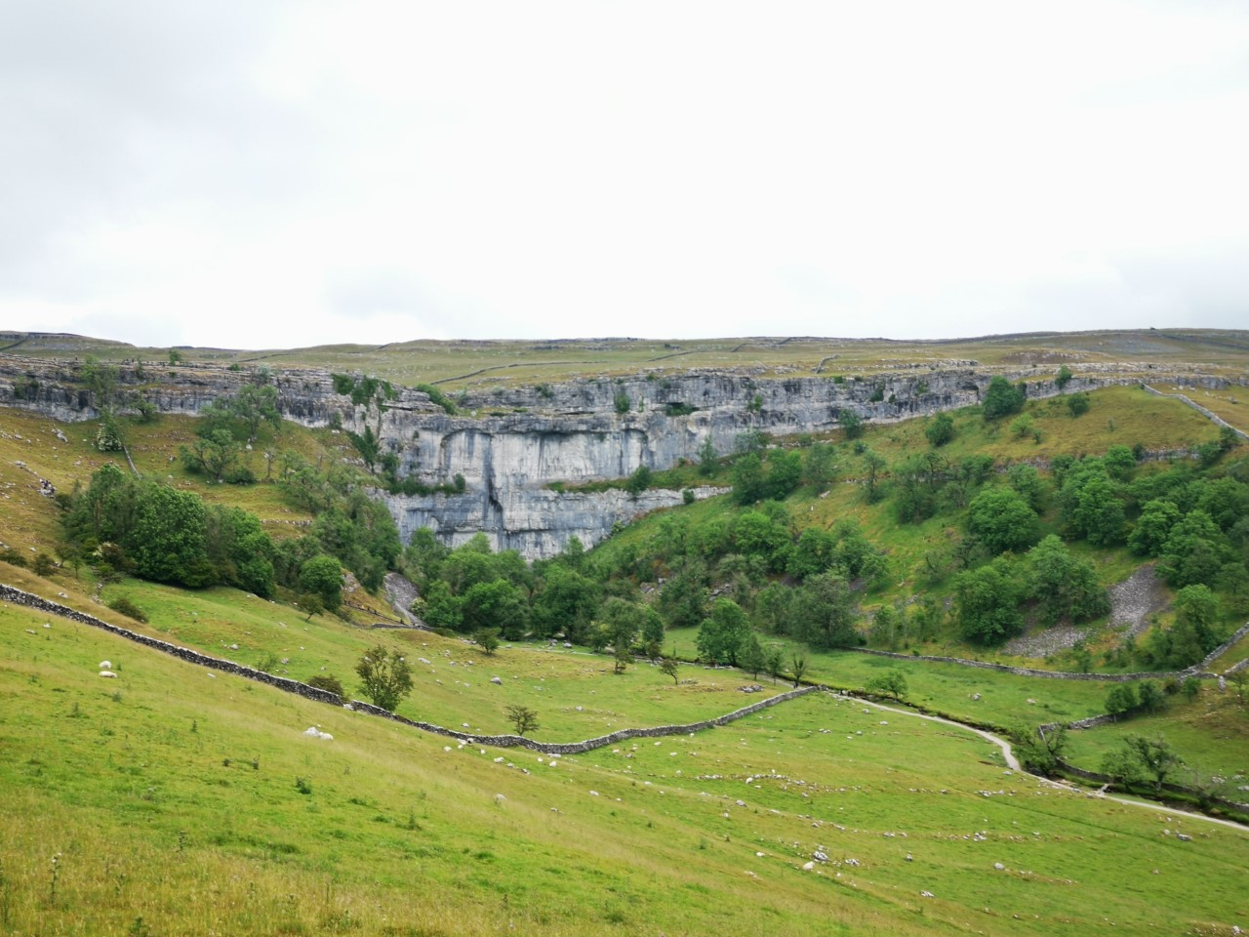
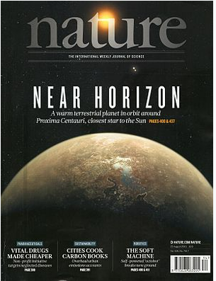
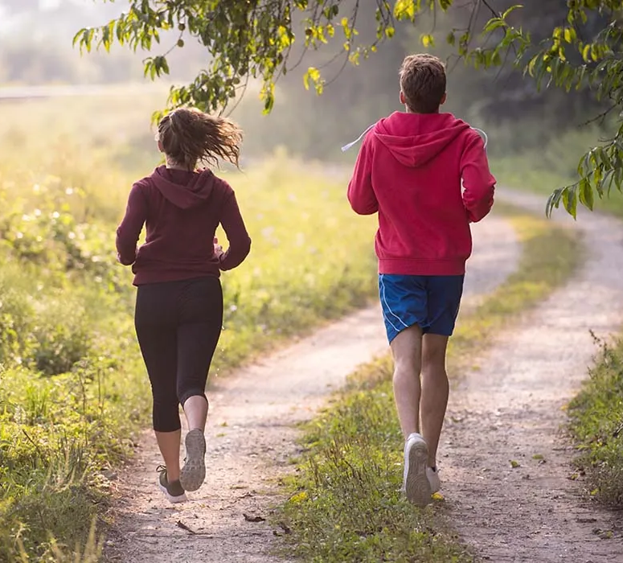
In general, ever felt stressed while writing?
Nature
YES
Exercise

